Slide 1
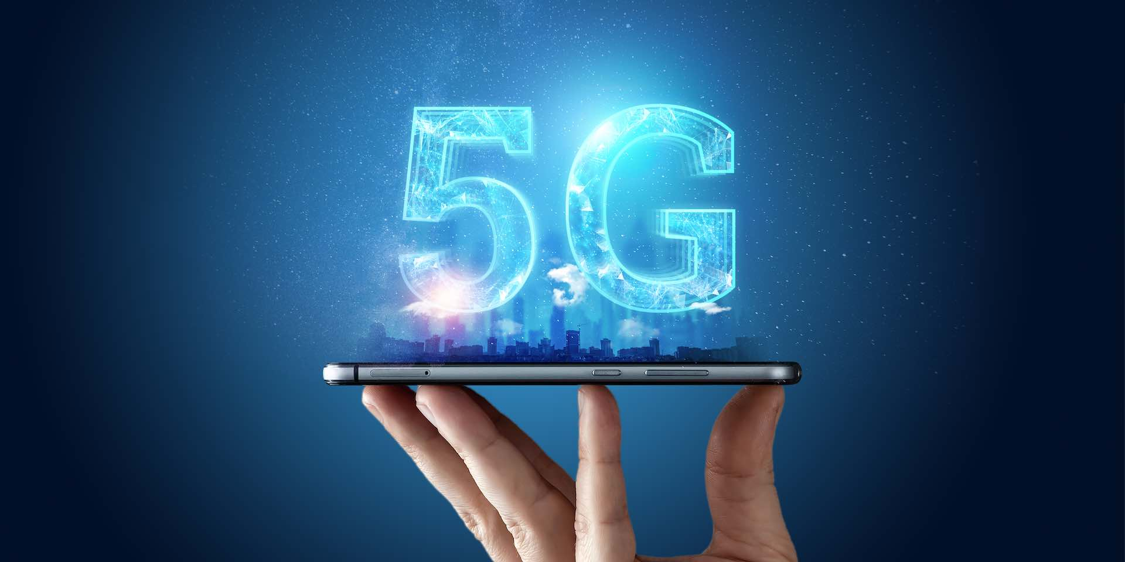
Machine learning for a 5G future
Presented By:
Md. Faruk Hosen(IT-17035)
Md. Nazmul Hasan(IT-17005)

Slide 2
Keynotes:
Machine Learning : What ?
Types and Process of Machine Learning
What is 5G?
5G opportunities
5G for Industry 4.0
Potential Benefits of ML for 5G
Demands on ML for 5G
ML for reconstruction of Capacity Maps

Slide 3
Machine Learning: What?
A branch of Artificial Intelligence(AI)
Machine Learning(ML) is concerned with the design and development of algorithms and techniques that allow computers to “learn”. The major focus of ML research is to extract information from data automatically, by computational and statistical methods. It is thus closely related to data mining and statistics.

Slide 4
Types of Machine Learning:
Supervised(Inductive) Learning
-Given: training data + desired outputs(labels)
Unsupervised learning
-Given: training data(without desired outputs)
Semi-supervised learning
-Given: training data and a few desired outputs
Reinforcement learning
-Rewards from sequence of actions

Slide 5
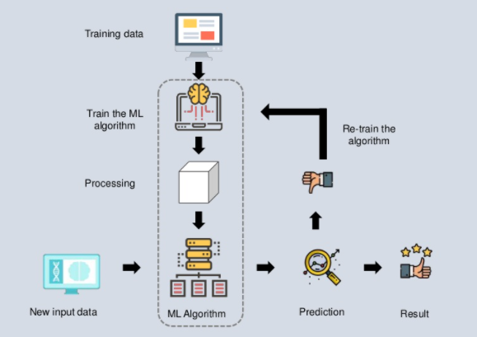
Machine Learning: How?
Google: Processes 24 peta bytes of data per day. Facebook: 10 million photos uploaded every hour. YouTube: 1 hour of video uploaded per second. Twitter: 400 million tweets per day.

Slide 6
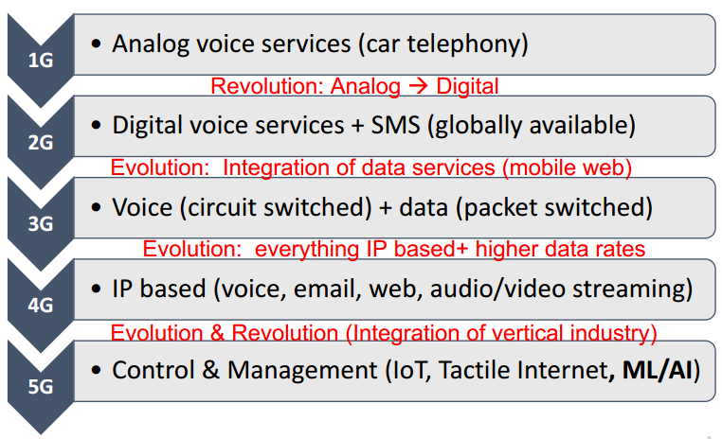
What is 5G?
5G is the 5th generation mobile network. It is a new global wireless standard after 1G, 2G, 3G, and 4G networks. 5G enables a new kind of network that is designed to connect virtually everyone and everything together including machines, objects, and devices.
Evolution of 5G:

Slide 7
When to Think about 5G:
The world is going faster and we're consuming more data every year, particularly as the popularity of video and music streaming increases. Existing spectrum bands are becoming congested, leading to breakdowns in service, particularly when lots of people in the same area are trying to access online mobile services at the same time.
5G is much better at handling thousands of devices simultaneously, from mobiles to equipment sensors, video cameras to smart street lights.

Slide 8
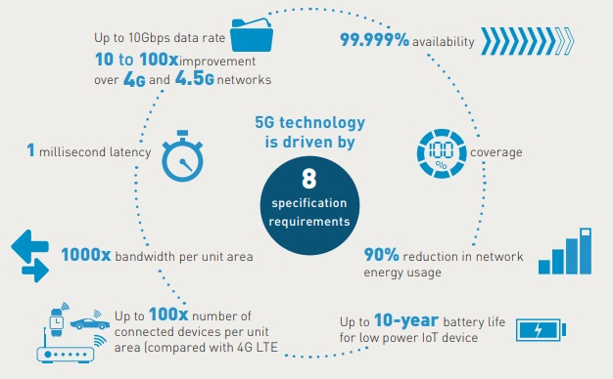
What 5G will bring to us:

Slide 9
5G opportunities:
5G for Industry 4.0:
• Reliable remote machine operation
• Predictive maintenance
• High precision positioning
• Industrial edge cloud
• Truck-to-X Communication
• Augmented worker/workspace
• Machine and process monitoring
• Secure remote access

Slide 10
5G opportunities:
5G in Networked Driving:
• Platooning
• Crossing traffic
• Collaborative driving
• Remote driving
• AR-based driver assistance
• Complete street perception
• Analysis of vehicle & driver conditions

Slide 11
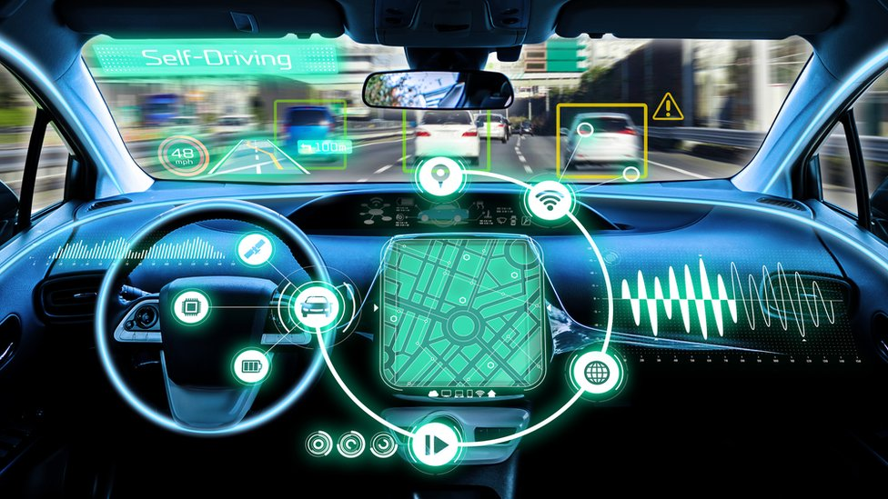
Example of Network driving :

Slide 12
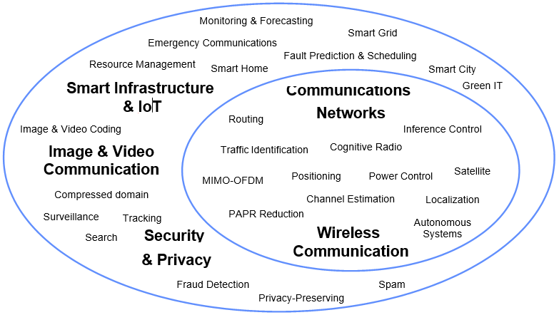
Machine Learning in Communications:

Slide 13
Potential Benefits of ML for 5G:
To enable us to cope with a massively increased complexity
- diminish mismatch between model and reality
To reduce measurements and facilitate robust decisions
- enabling massive connectivity, MIMO and mmWave
To facilitate self-organizing networks
- cognitive network management
To provide robust predictions
- QoS prediction, anticipatory networking

Slide 14
Demands on ML for 5G:
Robust online ML with good tracking capabilities
- ML with small (uncertain) data sets
Exploit domain knowledge (e.g. models, correlations)
- Hybrid-driven ML approaches
- Learn features that change slowly over frequency, time...
Distributed learning for efficient usage of scarce resources
- New functional architectures for Big Data analytics
Low-complexity, low-latency implementation
- New algorithms, massive parallelization

Slide 15
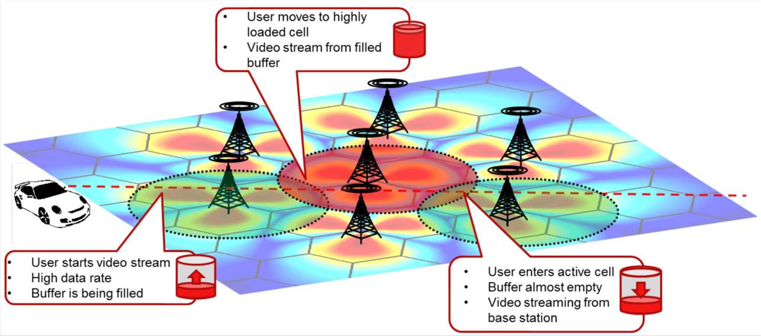
ML for reconstruction of capacity map:
Adaptive learning of long-term capacity maps.

Slide 16
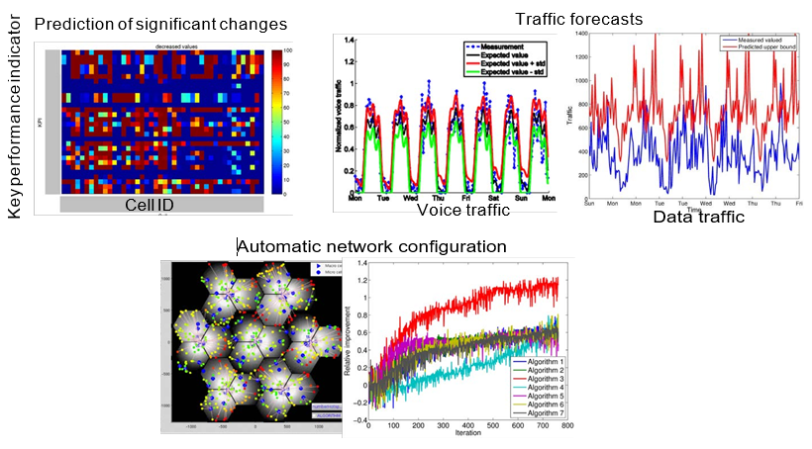
Others application of ML for 5G:

Slide 17
Thank You
For Your Attention

